Slide 1









Chongqing University of Technology
ATAI
Advanced Technique of Artificial Intelligence
Chongqing Unive
Constructing Emotion Consensus and Utilizing Unpaired Data for
Empathetic Dialogue Generation
（EMNLP-2021)
Reported by Zhaoze Gao

Slide 2

Chongqing University of Technology
ATAI
Advanced Technique of Artificial Intelligence
Chongqing University of Technology
1. Introduction
2. Approach
3. Experiments

Slide 3
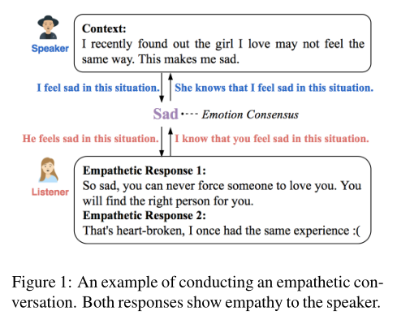




Introduction
• We point out that the empathetic dialogue generation contains bidirectional processes, and highlight the importance of constructing emotion consensus.
•we propose a novel dual-generative model that couples a forward and a backward dialogue model with a discrete latent variable capturing the shared emotion consensus.
• We utilize unpaired emotional data to break the constraint of paired empathetic data in the widely-used benchmark dataset EMPATHETICDIALOGUES

Slide 4
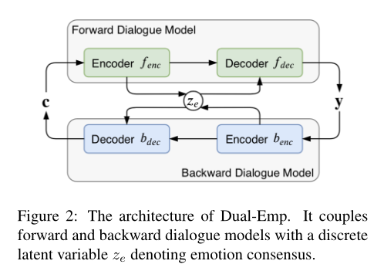


Approach

Slide 5
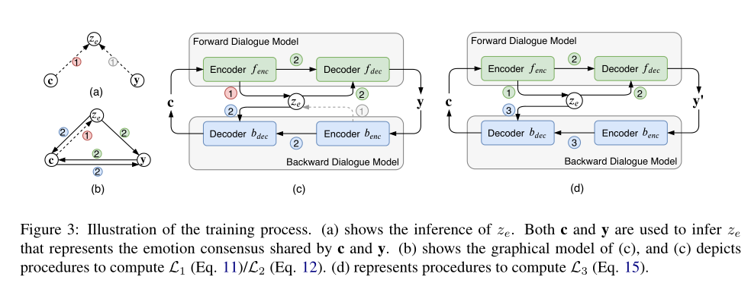
Approach

Slide 6
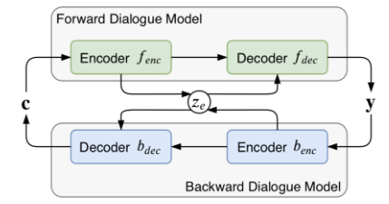





Approach
Encoder
Emotion Consensus Construction

Slide 7




Approach
Decoder

Slide 8
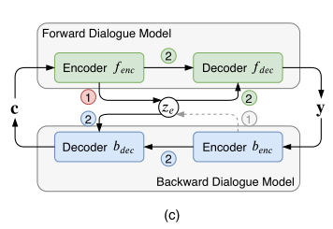


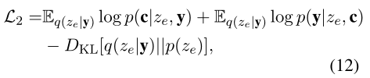

Approach
Training with Paired Data

Slide 9
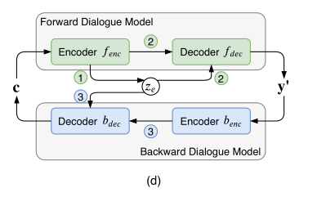







Approach
Training with Unpaired Data

Slide 10
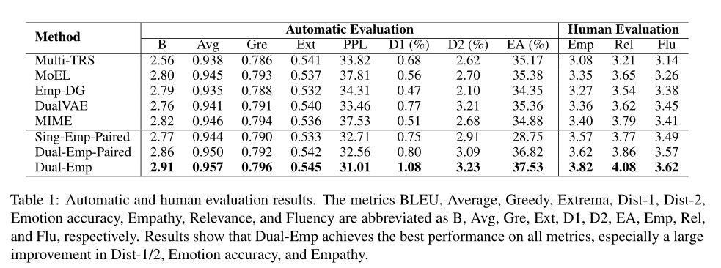
Experiments

Slide 11
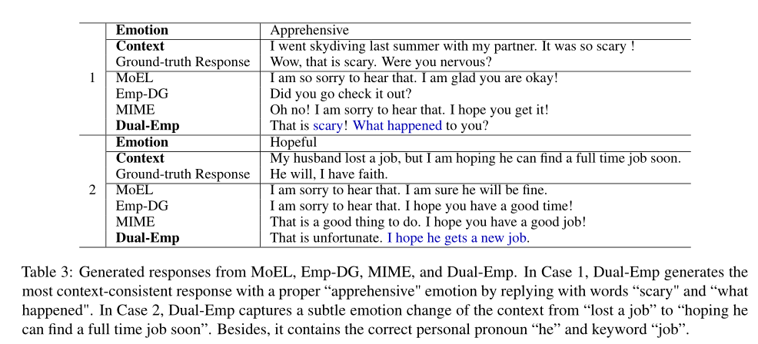
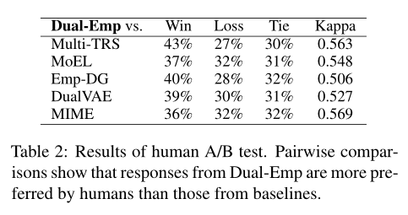
Experiments

Slide 12
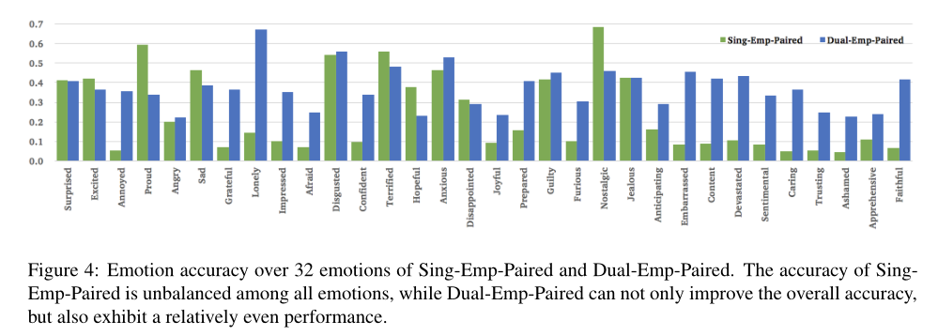
Experiments

Slide 13
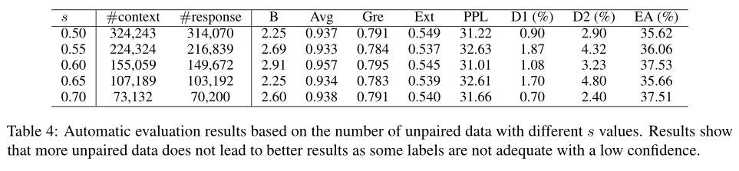
Experiments

Slide 14
Thank you！

